Slide 1

Azure Stack HCI The ideal hybrid infrastructure for retail

Slide 2
Agenda
Retail trends and transformation
Why use hyperconverged infrastructure
What is Azure Stack HCI and what it’s used for
Microsoft Azure Stack HCI and Arc for retail
Deployment in retail infrastructure
Customer success story
Next steps & resources

Slide 3




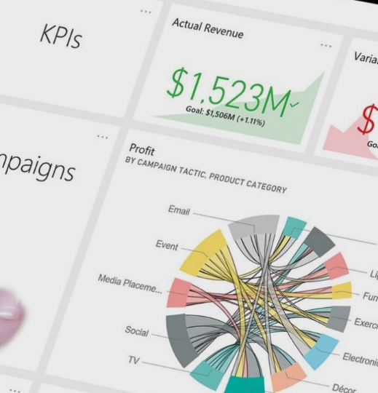
Retailers digital first mind set
Online sales supercharged
Loyalty shock
Multichannel fulfillment
Humanizing the digital experience
Data explosion
19% growth in global on-line sales in 2020
75% of US consumers have reported new shopping behaviors
85% of consumers have increased curbside pickup frequency
72% consumers say only engaged in personalized marketing
More data generated in next 2 3 years than in the past 30
Source: Statista, 2020
Source: McKinsey & Company, 2020
Source: INCISIV, 2020
Source: SmarterHQ, 2020
Source: IDC, 2020
Notes:
We have been witnessing a second wave of digital transformation over the past year affecting every company and every industry. Many structural changes that will outlast the pandemic. In Retail, offline merchants are embracing new business models, like contactless shopping and curbside pickup, while e-commerce has accelerated multiple years.
We have seen some interesting trends as a result, many of which we will most likely stick around for a while. Connecting the physical and digital experiences to better serve customers in new and more personalized ways – getting them the goods they want, where, when and how they want them is a pivotal for retailers.
With the explosion of data, focusing on leveraging both structured and unstructured data is essential for uncovering insights.
If 2020 taught us anything it was that no business is resilient to everything, but those retailers who laid their digital tracks early were better equipped to understand what was happening and take action to recover and continue to emerge stronger. They discovered newfound agility, deploying technology quicker than they have before, or thought possible. This enabled them to quickly adapt to this new world and better serve their customers.
The consumer journey and increasing connection between expectations – before, during, and after purchase is becoming essential for retailers.
-------------------------------------------------------
Additional talk track to be leveraged if needed:
Online sales supercharged: We witness years of e-commerce growth in a few months, hitting penetration levels forecasted 10 years from now. Globally we say on-line sales grow by 19% in 2020, and 31% increase in the US between 2019 and 2020. 4 in 10 consumers across Europe indicated they had purchased something online which they had only previously bought in-store.
Loyalty Shock: Consumers globally reacted to the crisis and the ensuing disruption by trying out new shopping behaviors. 50% of global shoppers said they shopped a new brand in 2020 and 75%. And 75% of US consumers reported new shopping behaviors. For example, 79% of consumers are using contactless payments citing safety and cleanliness as the key drivers.
Multichannel fulfilment: Since April 2020, retailers such as Target, state that Curbside pickup continues to show triple digit growth month over month. And 85% of US consumers have said they have increased their curbside pickup frequency. And now 43% of Top 500 global retailers with stores are offering curbside pick-up.
Humanizing the digital experience: To re-create the magic of instore retailers are leveraging experiential e-commerce approaches such as livestreaming and virtual clienteleing, along with delivering more personalized, targeted marketing. 72% of consumers say they only engage in personalized marketing from a retailer.
Data explosion: Employing billions of people globally, and representing almost 1/3 of the world’s GDP, the retail industry generates 40 petabytes of data an hour. And the evolution in the way we shop (73% of shopper journeys starting online, with $1.1 million spent online every minute in 2020) has led to an explosion of data. Yet most of that data, the demand single for the world in many respects is unstructured or dark/unused data. Now is the time to get a hold of all of that data, break down the silos of data that every retailer has and get more insight out of it. Creating a data estate that can be a true asset to a retailer’s business – gaining quicker time to insights to optimize the end-to-end value chain of retail – from better knowing their customers, empowering their employees, delivering an intelligent supply and reimagining retail.
SOURCES:
15 Eye-Opening Online Shopping Statistics for 2020 (sleeknote.com)
https://www.mckinsey.com/business-functions/marketing-and-sales/our-insights/the-great-consumer-shift-ten-charts-that-show-how-us-shopping-behavior-is-changing
https://www.businesswire.com/news/home/20200924005537/en/85-of-Shoppers-Have-Increased-Curbside-Pick-Up-Since-COVID-19-79-Say-a-Contactless-Store-Pickup-is-Very-Important-to-Them
https://www.smartinsights.com/ecommerce/web-personalisation/consumers-personalized-marketing-engagement/
IDC's Global DataSphere Forecast Shows Continued Steady Growth in the Creation and Consumption of Data

Slide 4





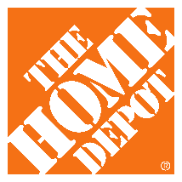











>94%
of Fortune 500 retailers use Microsoft Azure
Notes:
With that, we feel fortunate to have over >94% of Fortune 500 retailers are inventing with Azure.

Slide 5
Hybrid and multicloud is a game changer for transformation
82%
92%
of enterprises remain hybrid
of enterprises have a multi-cloud strategy
App modernization and innovation
Cloud and infrastructure management
Key drivers:
Legacy systems/custom requirements
Regulations and data sovereignty
Latency and technical hurdles
Consequence of no proactive strategy
Data modernization
Notes:
Hybrid is causing pain for partners
There is no consistent view into all the assets meaning there is no consistent management, security or governance
The varied flavors of customer databases have different end of support dates that need to be managed.
They also require different tooling, different expertise, and separate manual patching, deployment, backup and HADR.
It is hard to quickly react to customer needs and slow to implement the DevOps practice of CICD as it’s time consuming to set up for the databases. (continuous integration and continuous deployment)
...

Slide 6
Azure Stack HCI with Azure Arc powering retail transformation
Be future ready
Build on your terms
Operate hybrid seamlessly
Trust your cloud
Innovate to modernize applications and have access to latest innovative capabilities and next-generation technologies
Unified data strategy leveraging the open source, languages and framework, enabling interoperability and broad, hybrid solution offerings
Consistent performance and scalability across edge, hybrid and cloud
Comprehensive security and compliance industry coverage
Azure is the most complete digital production platform for retail use-cases
Notes:
Microsoft enables retail organizations to transform their business and deliver extraordinary customer service using an intelligent, trusted, and secure cloud platform. Microsoft Azure empowers you to quickly build and deploy solutions to gain actionable intelligence from the petabytes of data now common across modern retail.
Be future ready:
Immediate access to latest innovative capabilities and next generation technologies (AI, IoT, Mixed Reality, etc) for improving the digital shopping experience and providing superior customer experiences across multiple channels .
Innovate to modernize applications and keep up with evolving consumer expectations.
Build on your terms
Common data model and customer data platform remove data silos and provide accelerated, actionable and personalized insights.
Manage applications and design a unified data strategy leveraging a common data model, languages and framework support of your choice.
Operate hybrid seamlessly
Hybrid approach to benefit from on-premises investments while unlocking cloud innovation.
Consistent performance and scalability across edge, hybrid and cloud.
Trust your cloud
Leading device to cloud security that safeguards consumer data.
The most comprehensive compliance industry coverage of any cloud service provider.

Slide 7


Azure for Retail—operate hybrid seamlessly
Azure
Single control plane with Azure Arc
Bring Azure services to any infrastructure
Modernize retail infrastructure with Azure Stack HCI
Extend to the edge with Azure IoT
Notes:
Operate hybrid seamlessly: Azure takes a comprehensive approach and offers unique hybrid capabilities that give retailers the flexibility to innovate anywhere in their environment.
Azure Arc is the single control plane to seamlessly manage and secure your IT resources, such as Linux/Windows VMs and Kubernetes clusters, across multicloud, on-premises and the edge.
And, with Azure Arc enabled services, you have the flexibility to deploy Azure fully managed services anywhere – on-premises or in other public clouds.
With the Azure Stack portfolio, you can bring Azure consistent infrastructure to your own datacenters, even running it on existing certified hardware with Azure Stack HCI.
Lastly, we know that increasingly new apps often include running some aspects at the edge – like a retail store. So we’ve brought in our comprehensive Azure IoT portfolio so there is consistency in the developer, management, and security experiences
On-premises, in the cloud, or at the edge—Azure meets Retailers where they are. Azure enables Retailers to run operations on-premises, while relying on consistent performance. With the importance of hybrid models for, Azure allows Retailers to integrate and manage environments with tools and services designed for hybrid cloud.

Slide 8





Modernize retail environments with Azure Stack HCI
Azure hybrid by design
Azure Stack HCI
Modern subscription for flexible, familiar hyperconverged infrastructure
Enterprise scale and price performance
Familiar management and operations
Choice of deployment options

Slide 9



What is hyperconvergence?
Legacy “three tier” infrastructure
Ethernet switches
NETWORK
Misc. appliances
Hyperconverged infrastructure (HCI)
COMPUTE
Ethernet switches
Hypervisors
NETWORK
COMPUTE
STORAGE
Standard x86 servers
+
Local drives
+
The magic of software
NETWORK
COMPUTE
STORAGE
NETWORK
COMPUTE
STORAGE
Storage fabric
STORAGE
NETWORK
COMPUTE
STORAGE
Storage (SAN)
HCI is a software-defined, unified system that combines all the disparate and siloed elements of a traditional datacenter
Notes:
This slide introduces the concept of hyperconvergence. It relies on software defined storage and networking to enable aggregation of all server resources into a virtual pool that can be accessed directly from any of the servers in the cluster. Hyperconvergence eliminates the need for SAN, storage switches and network appliances…. Customers are left with servers and their internal disks, ethernet switches. Hyperconvergence reduces physical footprint, reduces the power and cooling requirements and greatly simplifies management.

Slide 10


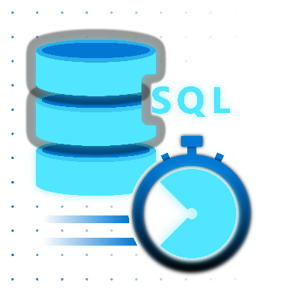

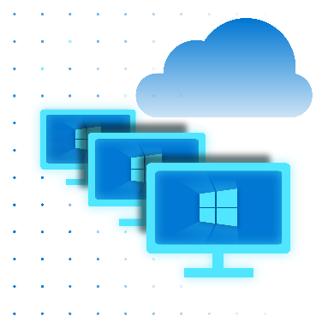



When to use Azure Stack HCI Run virtual machines on-premises and easily connect to Azure hybrid services
Modernize and secure your retail infrastructure
Affordably run intelligent edge and remote branch retail solutions
Industry-best performance for SQL Server databases
Deploy cloud native apps and Azure Arc enabled services through tight integration with AKS on HCI
Best in class virtual desktop experience with Azure Virtual Desktop for Azure Stack HCI
Notes:
There are 5 use cases that we talk about for Azure Stack HCI
Use these slides to tell the customer the best scenarios for using Azure Stack HCI
1. Modernize and secure your datacenter – with enterprise secure virtualization
2. Affordably run intelligent edge and remote branch solutions by providing appropriate infrastructure for these types of environments by leveraging the low price per core and the switchless capability of Azure Stack HCI and a true 2 node deployment (competitor typically starts at 3)
3. Industry-best performance for SQL Server VM – demonstrated through TPC benchmarks. Microsoft owns end to end stack for SQL Server providing better optimization of SQL Server virtual workloads.
4. Deploy cloud native apps and Azure Arc enables services - using AKS on HCI provides the Kubernetes platform that customer can use to take cloud apps and run them as a container on Azure Stack HCI. It also enables the deployment of all Azure Arc enabled services.
5. Best in class virtual desktop experience with Azure Virtual Desktop (AVD) for Azure Stack HCI

Slide 11

Azure Stack HCI brings the benefits of the cloud to your retail locations
Security and risk management
Scalability, high availability, and disaster recovery
Marketing integration and application modernization
Ability to manage and govern VMs from a single control plane
Secure-core server
2-16 Nodes &
Stretch cluster
PaaS on-prem
Azure portal integration
Azure Stack HCI delivers innovation with increased focus on data security when retail workloads cannot operate in the cloud
Notes:
Recent global events have made way for a second wave of digital transformation over the past year. In retail, brick and mortar merchants have embraced new business initiatives, like contactless shopping and curbside pickup,
at an unprecedented pace.
Connecting physical and digital experiences to better serve customers in new and more personalized ways—getting goods to customers where, when, and how they want them—is now pivotal for retail sustainability and growth.
Retailers who have started or are willing to quickly embrace modern technology now have the ability to adapt quicker than ever thought possible.
Hyper-growth of e-commerce will continue to be the norm, with an increased focus on data security, requiring retailers to aim technology investments at driving innovation, hardening consumer data security, and building deeper connections with customers. Cloud technology can help, but not all retail workloads can live in the cloud.

Slide 12
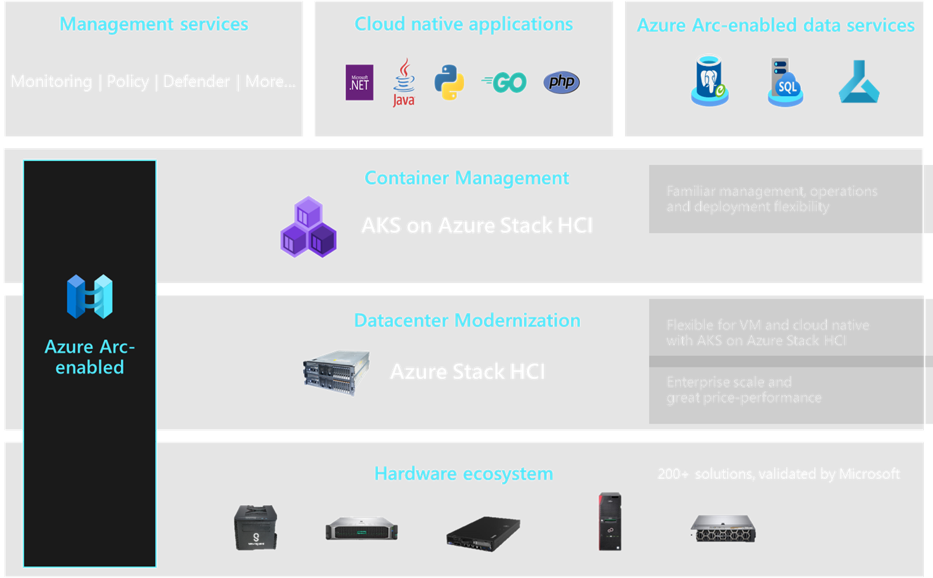




Modernizing retail computing infrastructure with Azure Stack HCI
Innovative technologies for your retail environment:
Proven software defined technologies for hyperconvergence
Familiar Hyper-V based compute resource
Single control plane management enabled by native integration with Azure Arc
Connectivity to multiple Azure services
Ability to run cloud apps on-prem
Broad hardware choice that can be tailored to retail environments
Management services
Cloud native applications
Azure Arc enabled data services
Monitoring | Policy | Defender
And more…
Container management
Azure Arc enabled
Familiar management, operations, and deployment flexibility
AKS on Azure Stack HCI
Datacenter modernization
Flexible for VMs and cloud native apps with AKS on Azure Stack HCI
Enterprise scale and great price-performance
Azure Stack HCI
Hardware ecosystem
350+ solutions, validated by Microsoft
Notes:
Azure Stack HCI is a world-class, Azure Arc-enabled virtualization stack built on proven technologies that have already been deployed at scale (such as Storage Spaces Direct and Hyper-V) with hybrid cloud capabilities built in. An Azure Stack HCI solution includes:
Azure Stack HCI operating system
Validated hardware from a hardware partner
Azure hybrid services
Windows Admin Center
Hyper-V-based compute resources
Storage Spaces Direct-based virtualized storage
SDN-based virtualized networking using Network Controller (optional)
Single control plane management enabled by native integration with Azure Arc

Slide 13












Deploy hybrid cloud to your retail infrastructure
Up to 16 nodes for scalability and start at switchless 2 nodes for low-cost entry point
Simplicity of architecture bringing the right hardware for the retail environment
Run your critical process on-prem (ex. POS) and benefit from data protection through the Azure cloud
Monitor and manage all your retail locations through a single pane of glass
On premises
Azure Cloud
Azure Stack HCI
Cluster interconnect
Azure Automation
Azure Update Management
Azure File Sync
Azure Network Adapter
Azure Security Center
Azure Arc
Azure Policy
Azure Monitor
Azure Backup
Azure Site Recovery
Storage Replica
Notes:
Scalability & Low Cost Entry Point
A single Azure Stack HCI deployment can contain as few as 2 nodes (or as many as 16), offering a very low entry point cost.
Simplicity of architecture bringing the right hardware for the retail environment Physical space at the retail site is kept low by eliminating the need for a high-speed switch or external storage.
Run your critical process on-prem (ex. POS) and benefit from data protection through the Azure cloud
Monitor and manage all your retail locations through a single pane of glass. Scalability with Azure Stack HCI can reach thousands of retail locations, while providing scale performance that is nearly linear as more nodes are added to ease capacity planning, forecasting, and purchasing as your deployment grows.
Subscription model optimizes costs for each individual store. Since this Azure service is charged at $10/month per physical instance, you only need to pay for the capacity you need at each individual store.

Slide 14












Bring the full deployment of cloud resources on-prem
Example of a typical Azure Stack HCI deployment in retail
Azure Stack HCI
Azure Cloud
Virtual machines
IoT Hub
Leverage Azure Arc data service on-prem for your intensive data analysis in-store
With AKS on HCI you can automate container deployment in your stores for apps you can’t run in the cloud
Cost reductions for secure collaboration and management are provided through Azure Defender and Azure Sentinel
Web Apps
Data factory
Storage
Arc Data Services
Update Management
Kubernetes
Azure Backup
Azure Monitor
Arc enabled Kubernetes
Virtual machines
Azure Cloud
Security center
Key Vault
Azure AD
IoT hub
Sentinel
Azure Policy
Log analytics
Defender for IoT

Slide 15

Retail customer story
Situation
Major US retail grocery chain (1,400+ stores) identified need to modernize store IT infrastructure to run POS operations locally
Solution
A switchless 2 node tower form factor, Azure Stack HCI cluster in each store connected to Azure
Benefits
A low entry point solution with the right amount of compute power to run POS locally
Automatically backed up with Azure
Native integration with Arc makes it possible to monitor all the clusters in the stores from a central location
Notes:
Read the full story:
A large US retail grocery chain was faced with the need to modernize 1400+ stores running Windows Server 2012 with a small datacenter footprint and onsite POS operations.
With local storage only, its vast number of stores were reliant on just 2 legacy Hyper-V servers, not clustered or hyperconverged. Full scale modernization using traditional methods would have taken years to complete and cause significant operational disruption. It needed a new, hybrid
implementation to add cloud services, modernize applications, and support greater resiliency and fault tolerance.
The chain chose to modernize to a 2 node Azure Stack HCI cluster, which offered the flexibility to maintain POS and legacy VMs onsite at each retail location while still supporting centralized management at scale.
As a result of implementing Azure Stack HCI with the full power of Microsoft Azure at each retail location, the grocery chain was able to improve performance and reliability, increase scalability with high availability, and enhance disaster recovery, all at a lower total cost of ownership for each
retail location.

Slide 16
Microsoft Azure powering the cloud for retailers
Edge Devices
Azure Stack HCI
Azure Arc Enabled Server
Azure Sphere
Azure Kinect
HoloLens
Serverless
Web
Mobile
Mixed Reality
Containers
Events + Integration
Databases
Analytics
AI + Machine Learning
Internet of Things
Media
Tools
Visual Studio
GitHub
Power Apps
Power BI
Infrastructure
Compute
Networking
Storage
Security
Identity

Slide 17
The purpose of bringing Azure Stack HCI and Azure Arc together is to deliver the best of Azure to our retail customers, on their infrastructure, that they control, with their preferred tools, on their premises.

Slide 18

Next steps
Learn more about our vision for digital transformation at microsoft.com/Retail
Our perspectives in blogs, videos, and articles
Customer stories
Events and webcasts
Social channels
Learn more about Azure at Azure for Retail – Multichannel Technology | Microsoft Azure
Learn more about Azure Stack HCI Azure.com/HCI
Notes:
Read the full story:
A large US retail grocery chain was faced with the need to modernize 1400+ stores running Windows Server 2012 with a small datacenter footprint and onsite POS operations.
With local storage only, its vast number of stores were reliant on just 2 legacy Hyper-V servers, not clustered or hyperconverged. Full scale modernization using traditional methods would have taken years to complete and cause significant operational disruption. It needed a new, hybrid
implementation to add cloud services, modernize applications, and support greater resiliency and fault tolerance.
The chain chose to modernize to a 2 node Azure Stack HCI cluster, which offered the flexibility to maintain POS and legacy VMs onsite at each retail location while still supporting centralized management at scale.
As a result of implementing Azure Stack HCI with the full power of Microsoft Azure at each retail location, the grocery chain was able to improve performance and reliability, increase scalability with high availability, and enhance disaster recovery, all at a lower total cost of ownership for each
retail location.

Slide 19
Azure Stack HCI resources
Read
Watch
Do
Azure Stack HCI Product Page: https://www.azure.com/hci
Azure Stack HCI for Retail:
https://aka.ms/ASHCIretailebook https://aka.ms/ASHCIretailinfographic
Datacenter Modernization Whitepaper: https://aka.ms/datacentermodernizationwp
Technical Use Cases Whitepaper: https://aka.ms/technicalusecaseswp
Hybrid Cloud Essentials Whitepaper: https://aka.ms/hybridcloudessentials
ESG Analyst Report: https://aka.ms/esgtechnicalvalidation
Discover Azure Stack HCI: https://aka.ms/discoverazurestackhci
Azure Virtual Desktop for Azure Stack HCI: Azure hybrid updates—YouTube
Securing Azure Stack HCI with Azure Defender and Secured-core: https://aka.ms/securingASHCI
Product tour of Azure Stack HCI using WAC: https://aka.ms/deployhciwithwac
Disaster Recovery with Stretch Clustering: https://aka.ms/stretchclustervideo
Technical roadmap feature videos: Kernel Soft Reboot, Every Node Arc-Enabled, Intent Driven Networking, GPU Management, Multi-cluster Monitoring, Automatic Virtual Machine Activation
Get started with the Azure Stack HCI Trial: https://aka.ms/evaluate-hci
Visit Tech Docs to see how it all works: https://aka.ms/hci-docs
Visit the Azure Stack HCI Catalog: https://aka.ms/azurestackhcicatalog
Get training: Azure Stack HCI foundations Operate and maintain Azure Stack HCI

Slide 20
Thank you!

